Slide 1
Meal Volunteer Kitchen Orientation

Slide 2
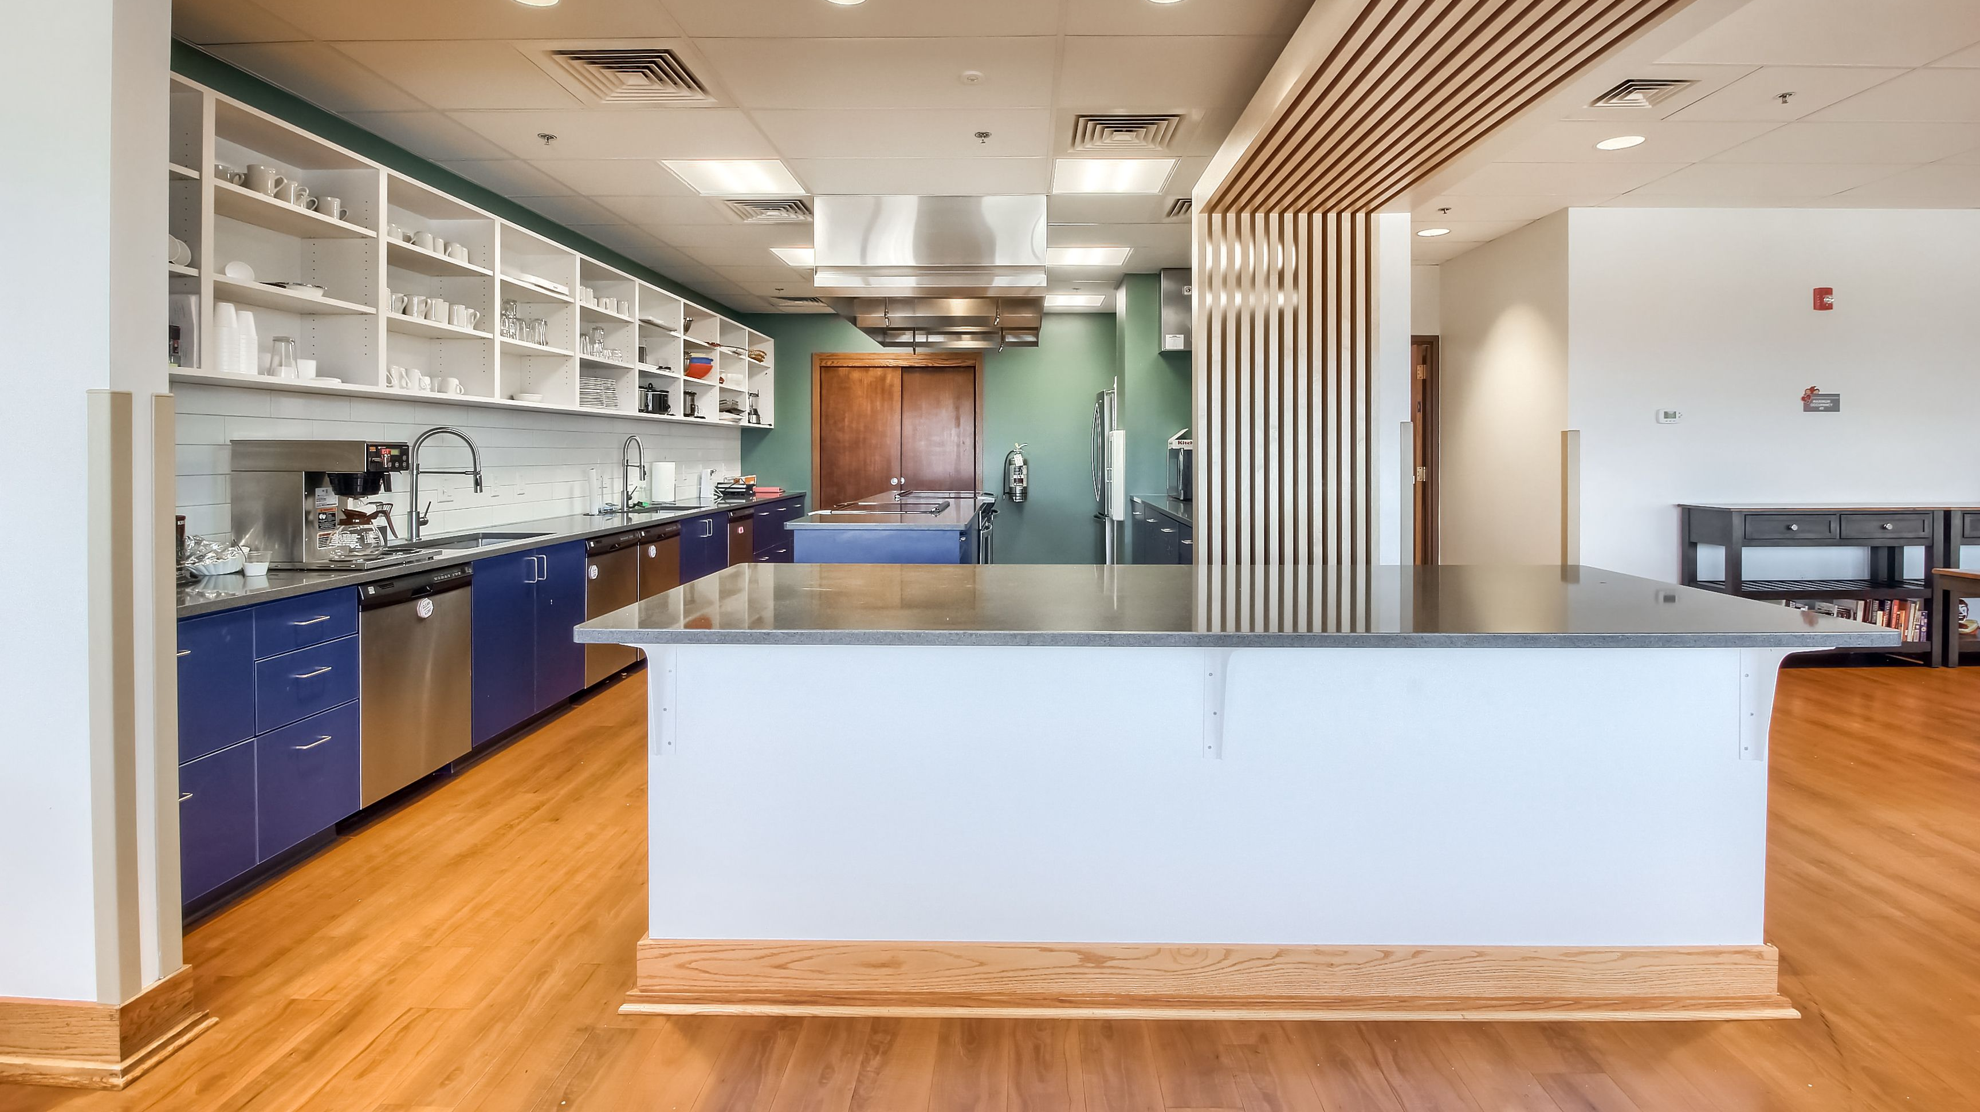
Denver Meal Volunteer Kitchen
Our Meal Volunteer Kitchen is for volunteer groups only.
It is only open to families when it is time to eat.

Slide 3
Denver Meal Volunteer Kitchen
2 stovetops
3 ovens
4 dishwashers
1 large refrigerator/freezer
2 sinks
Small appliances: microwave, coffee maker, blender, food processor, instant pot, crock pot, electric griddles, hand mixers, etc.
Pots, pans, baking dishes, baking sheets, cooking tools, cutting boards, serving utensils, etc.

Slide 4
Denver Meal Volunteer Kitchen Dining Room
We have all the serving supplies you will need: plates, bowls, cups, mugs, silverware, etcetera

Slide 5
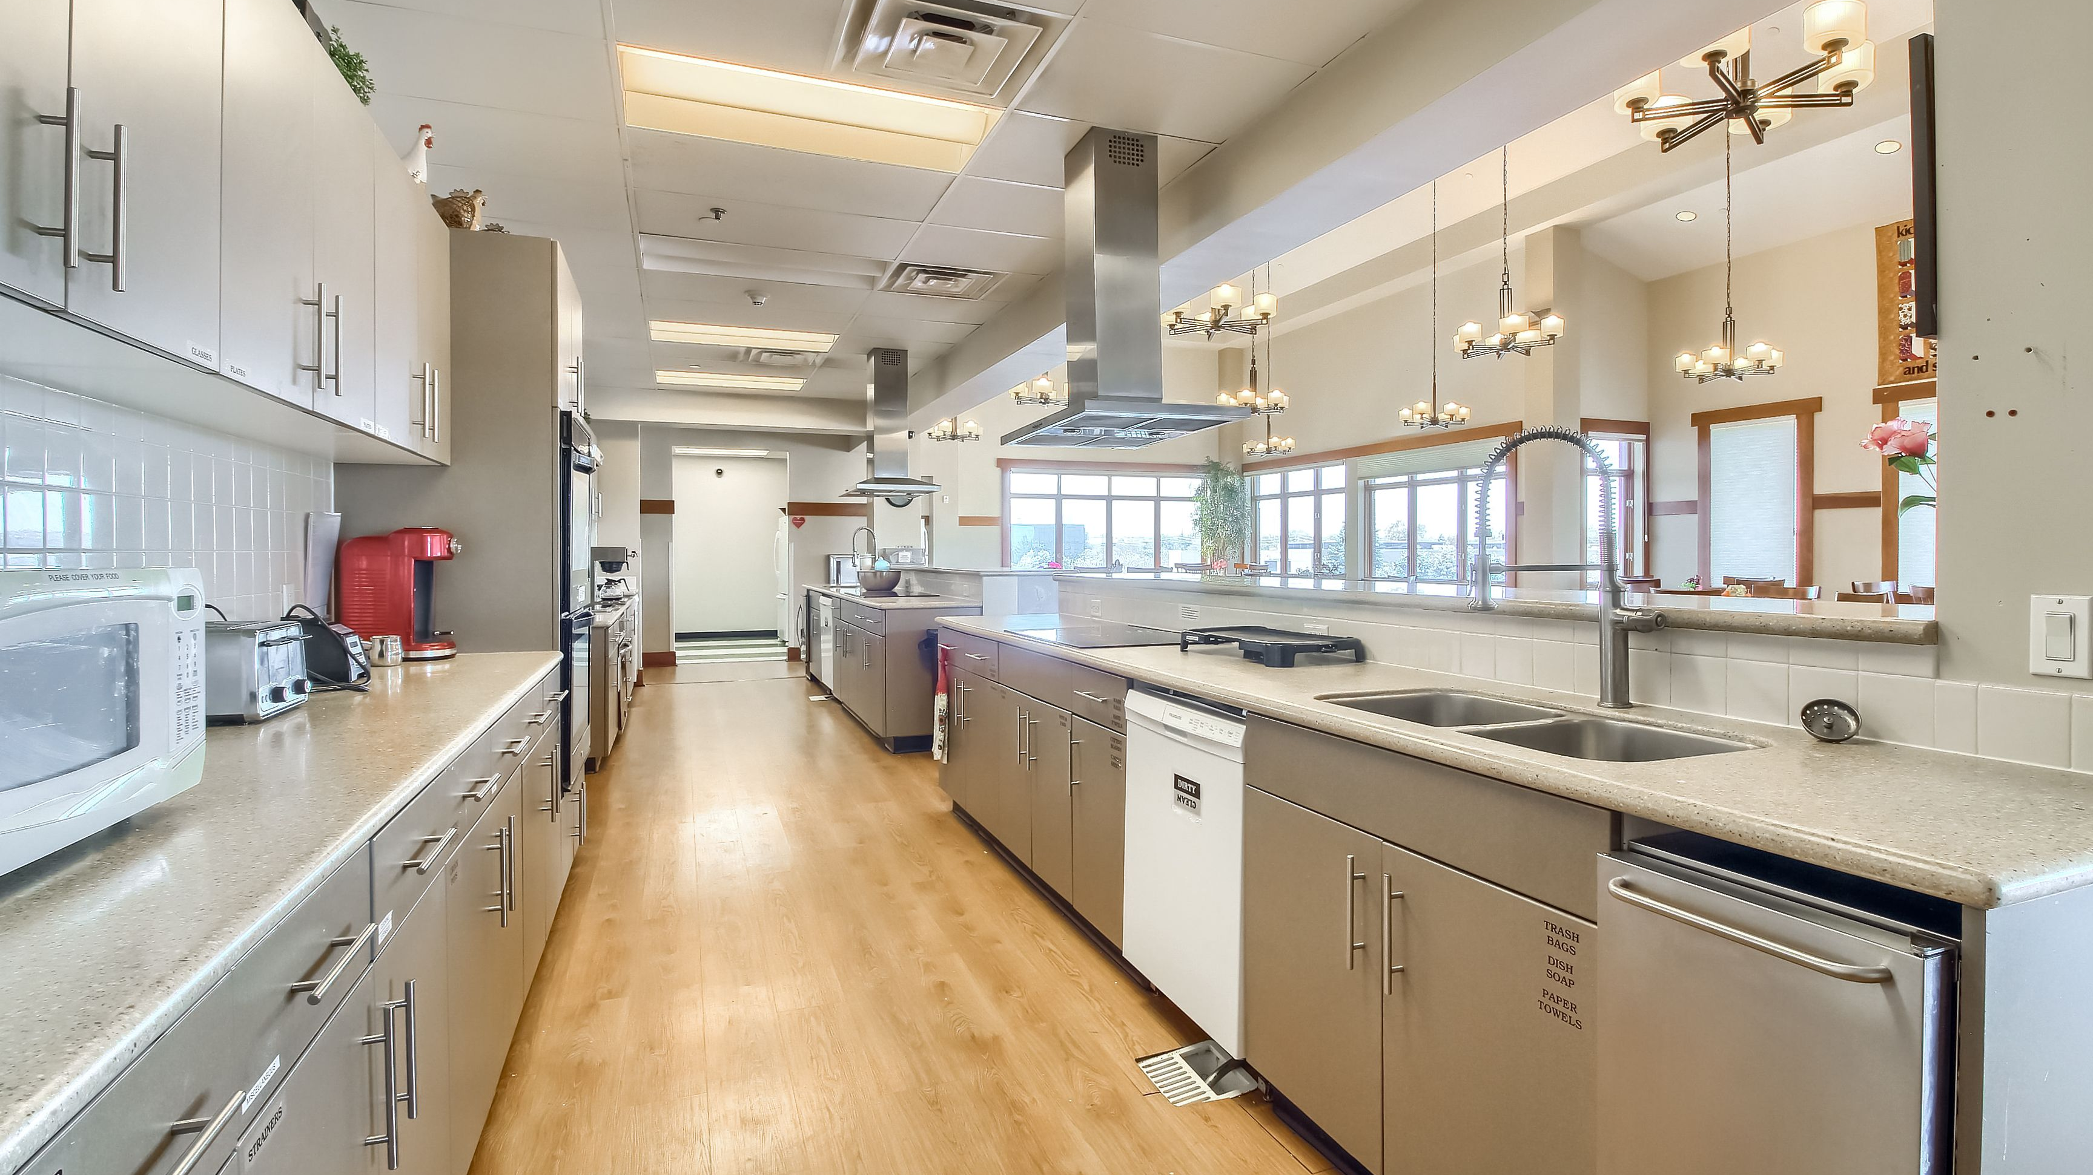
Aurora Meal Volunteer Kitchen
The third-floor kitchen is a shared space between meal volunteers and the families staying on our third floor.

Slide 6
Aurora Kitchen
3 ovens
3 stovetops
2 sinks
4 dishwashers
Small Appliances: Microwave, toaster, blender, hand mixer, instant pot, electric griddle, crock pot, etc.
Many pots, pans, baking dishes, baking sheets, cooking tools, cutting boards, serving utensils, etc.

Slide 7
Aurora Dining Room
We have all the serving supplies you will need: plates, bowls, cups, mugs, silverware, etcetera

Slide 8
Feel free to reach out with questions!
If you are wondering about specific equipment or tools, we can let you know if our kitchens have them.
We have a small collection of baking supplies and spices that are available for you to use. Let us know what you are looking for and we can let you know if we have it!

Slide 9
Donations Welcome! ☺
We are always looking for donations of kitchen items for our 6 kitchens (between the two houses!)
All items must be new, unused, and nonexpired.
Non-perishable food items
Spices and baking ingredients
Oven mitts, kitchen towels, hot pads, trivets
Spatulas, kitchen scissors, can openers, whisks, paring knives, metal serving utensils, measuring cups, handheld knife sharpener
Cutting boards, baking dishes, baking sheets, loaf pans, muffin tins
Small appliances: rice cookers, air fryers, instant pots, KitchenAid mixer, food processor, waffle irons

